Slide 1
My Trip to the Southeast

Slide 2
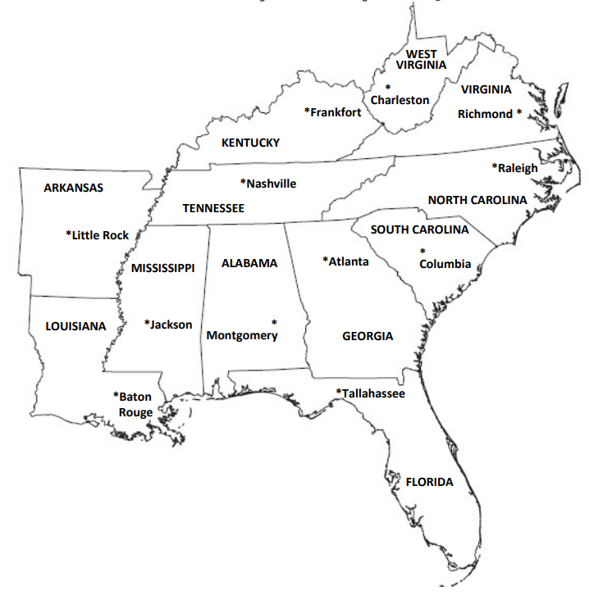
This is the southeast map and forida

Slide 3
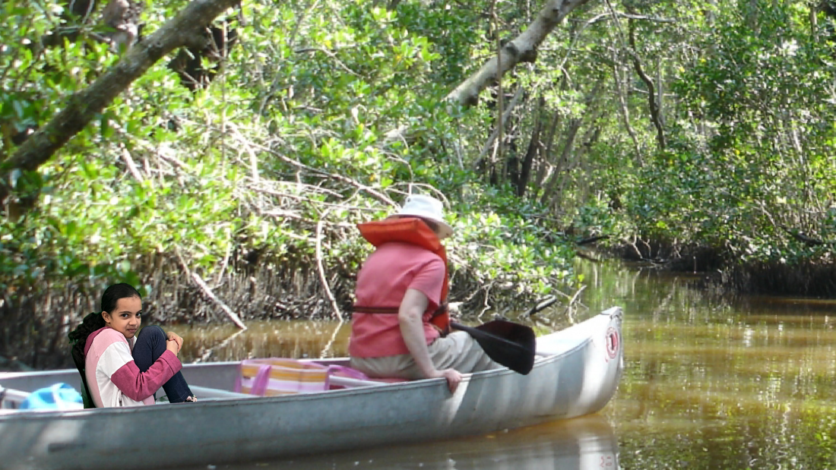
Everglades
I this is me in the Everglades
And I’m was so sard with my grama on vacation and I sea an alligator witch made me so scared
and I sea a deer and I sea a panther witch it tried to get us but we explored that the panther was scared of water like cats and the national park was like that but not a llwas.in the old day they treated it like a bad boy dog.

Slide 4
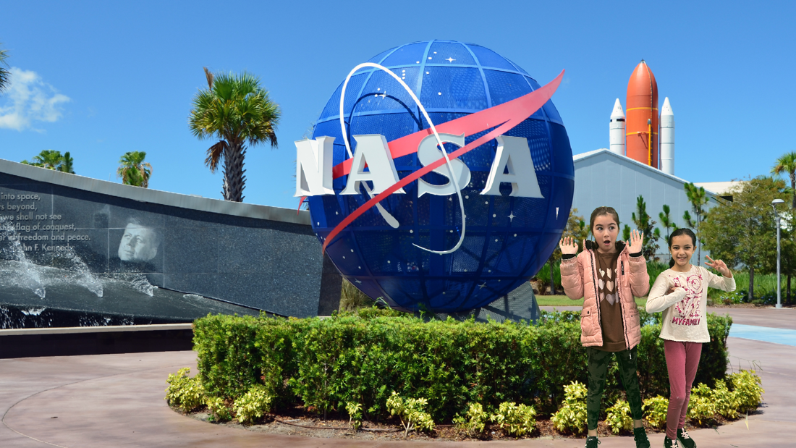


























Kennedy space center
I my name is Taleen and today I am at the Kennedy space center so some information there my family and I felt how to be in a space ship it made me feel sick like I wanted to throe up and you can ask quotation that you rally wanted to ask them and you are gana see the first ship that went to space and I hope you had lots of fun wane you went there byyy.

Slide 5
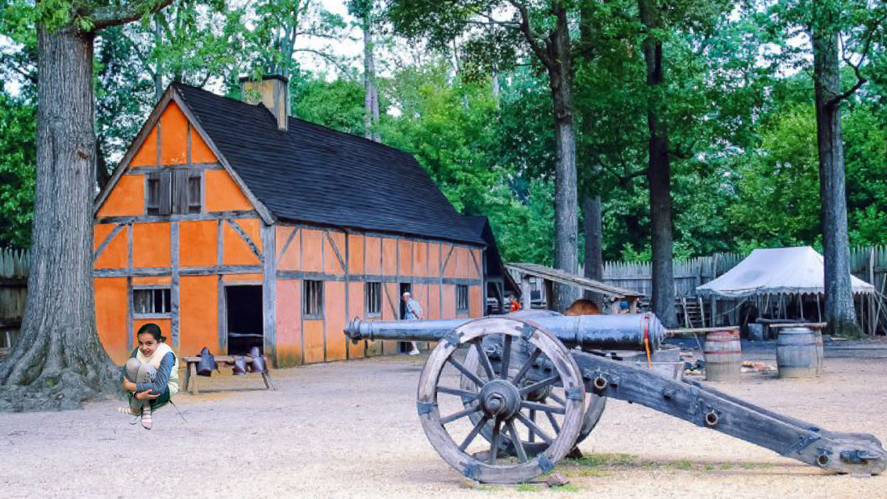
Jamestown, Virginia
Today we visited Jamestown
And I am going to tell you abut it and it is an a rally old place
People yuset to have a hard time there and people then kept a taking them a lot and people died because miscitos
And they died from Bing hangry.

Slide 6
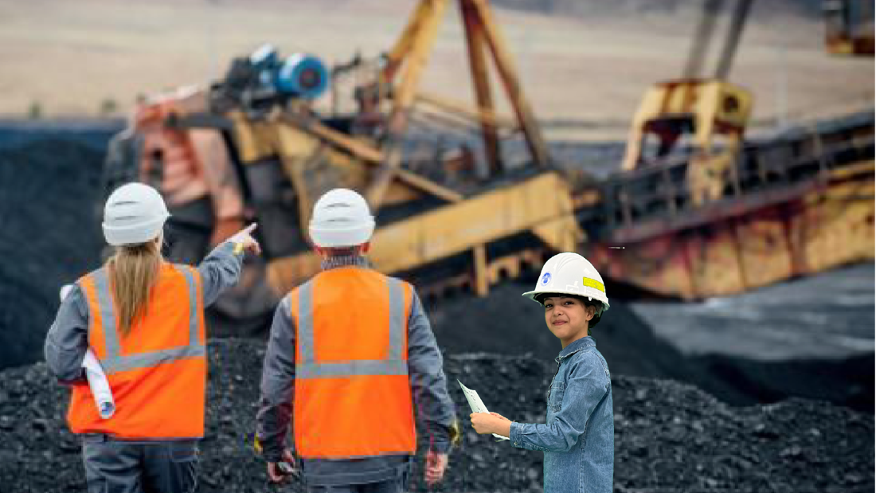
A coal mine in Appalachia
I me today I am at the mine and I am going to tell you abut it people mine in the old days there were more people work for the mine now there are less people work there and they dig strait front.

Slide 7
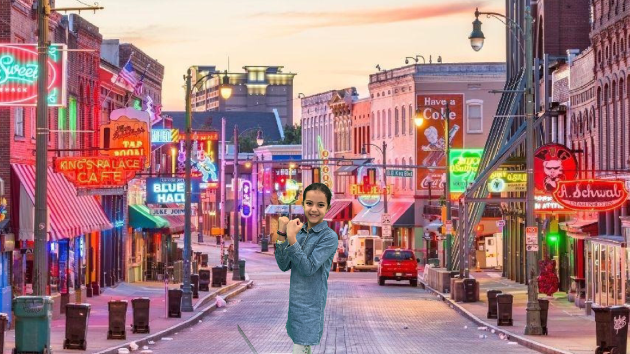
Tennessee
We made a short stop in Memphis Tennessee tis place is known as the birthplace of the “ blue “. The blue were crated by slaves as a way to express their sorrows. Today the blue can be heard though out Memphis.

Slide 8
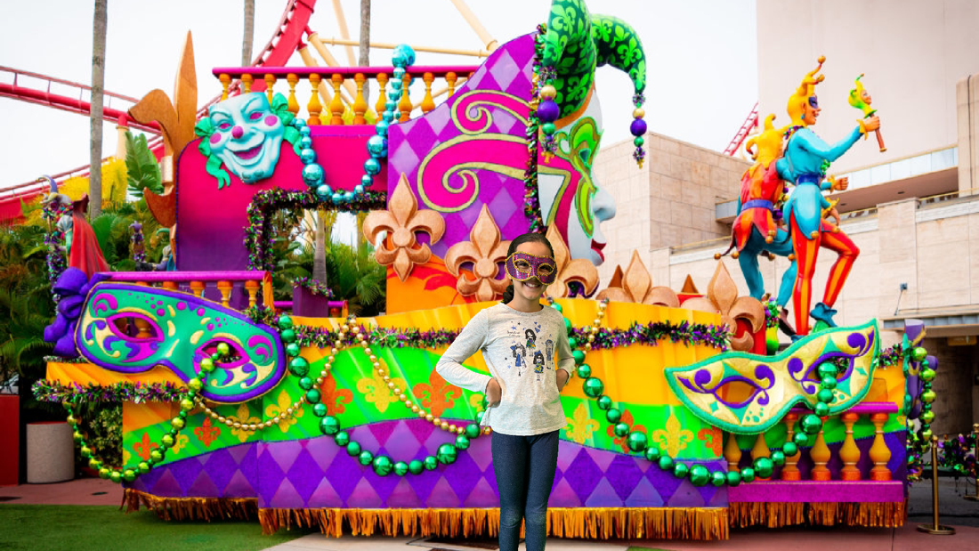
New Orleans
Hi it's time for another trip we are going to the French Quarter in New Orleans yeah it gets floated a lot from the Mississippi River. Ye but I'm not here for a long time I'm just for a little time. And it is also musical place and they had heard a really hard time with flooded . I think it's time to kind of go back but we have to have a little fun time and I think it's time because it’s feel like it's going to get for it flooded

Slide 9
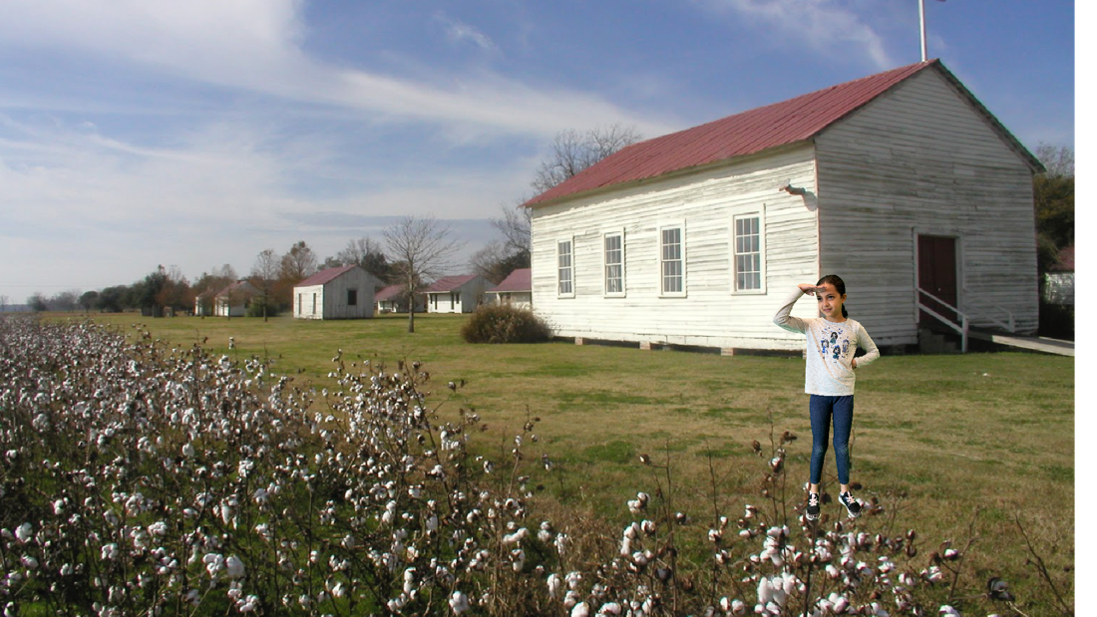
Plantation in Natchez , Mississippi
Hi I feel sad in the 1800 hundreds there was so much slavery’s but I am happy that slavery has abolished.

Slide 10
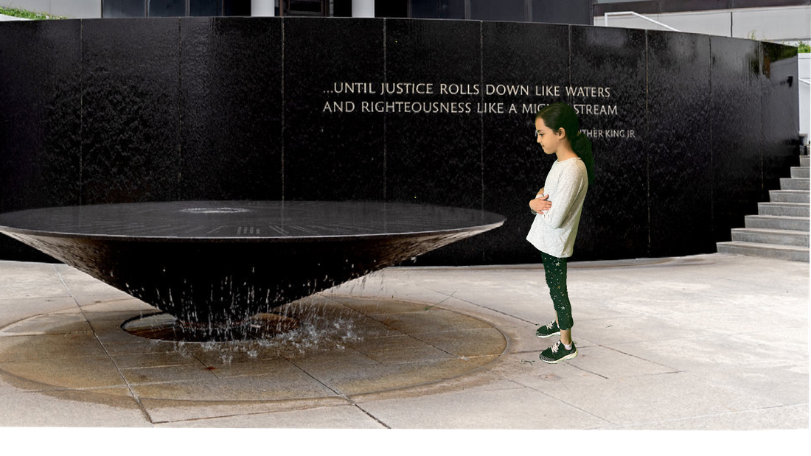
Alabama Montgomery
They are unfair they style are mean to them and they make them feel unhappy. Names of 40 Amirian killed in CRM. And now some people are beter but some are treated unfair.

Slide 11


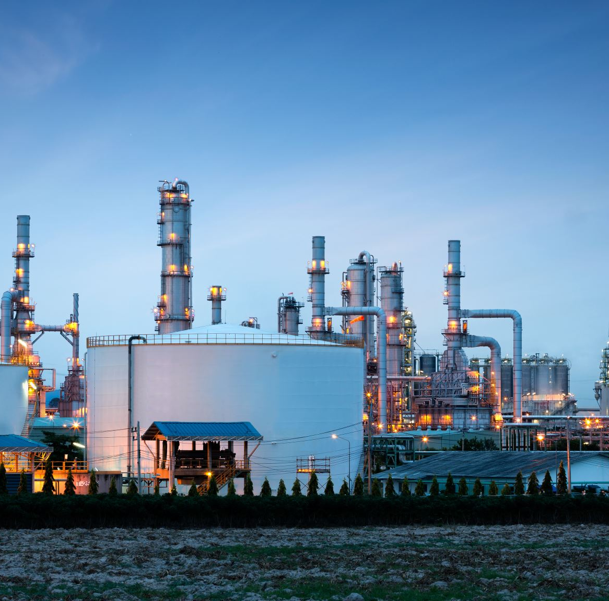
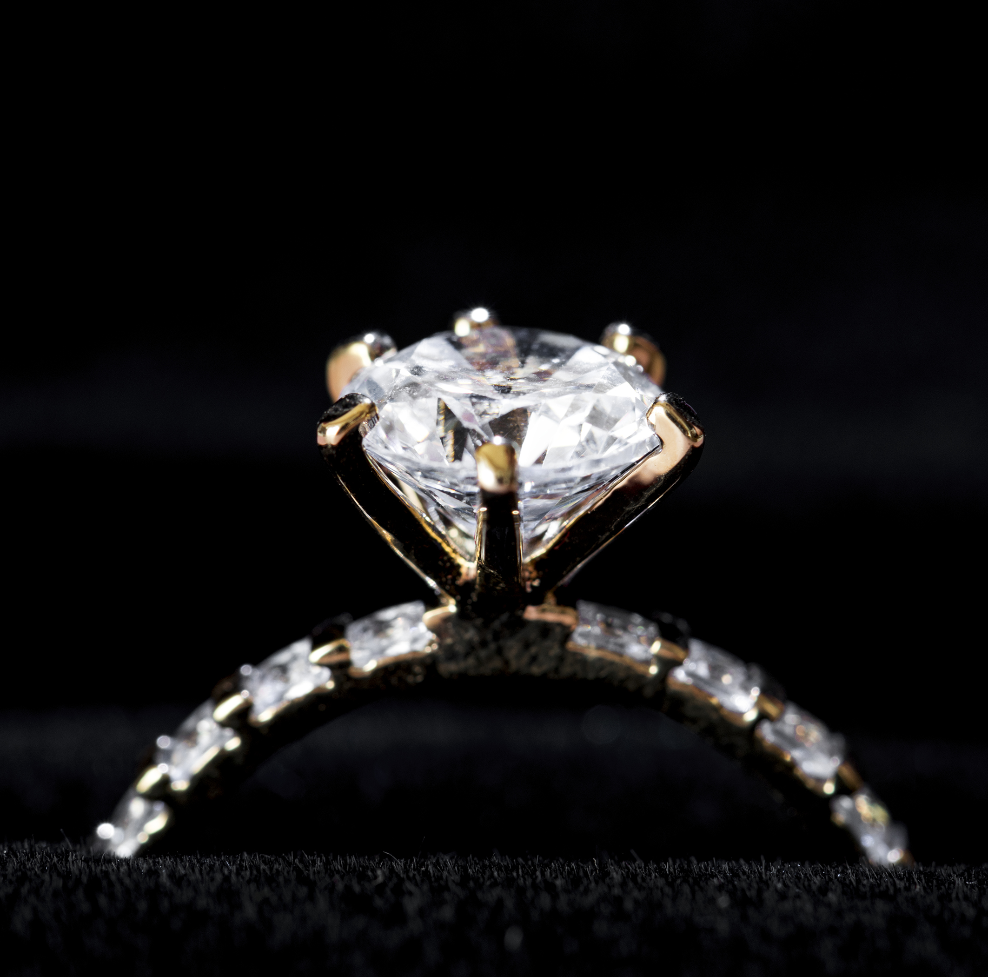
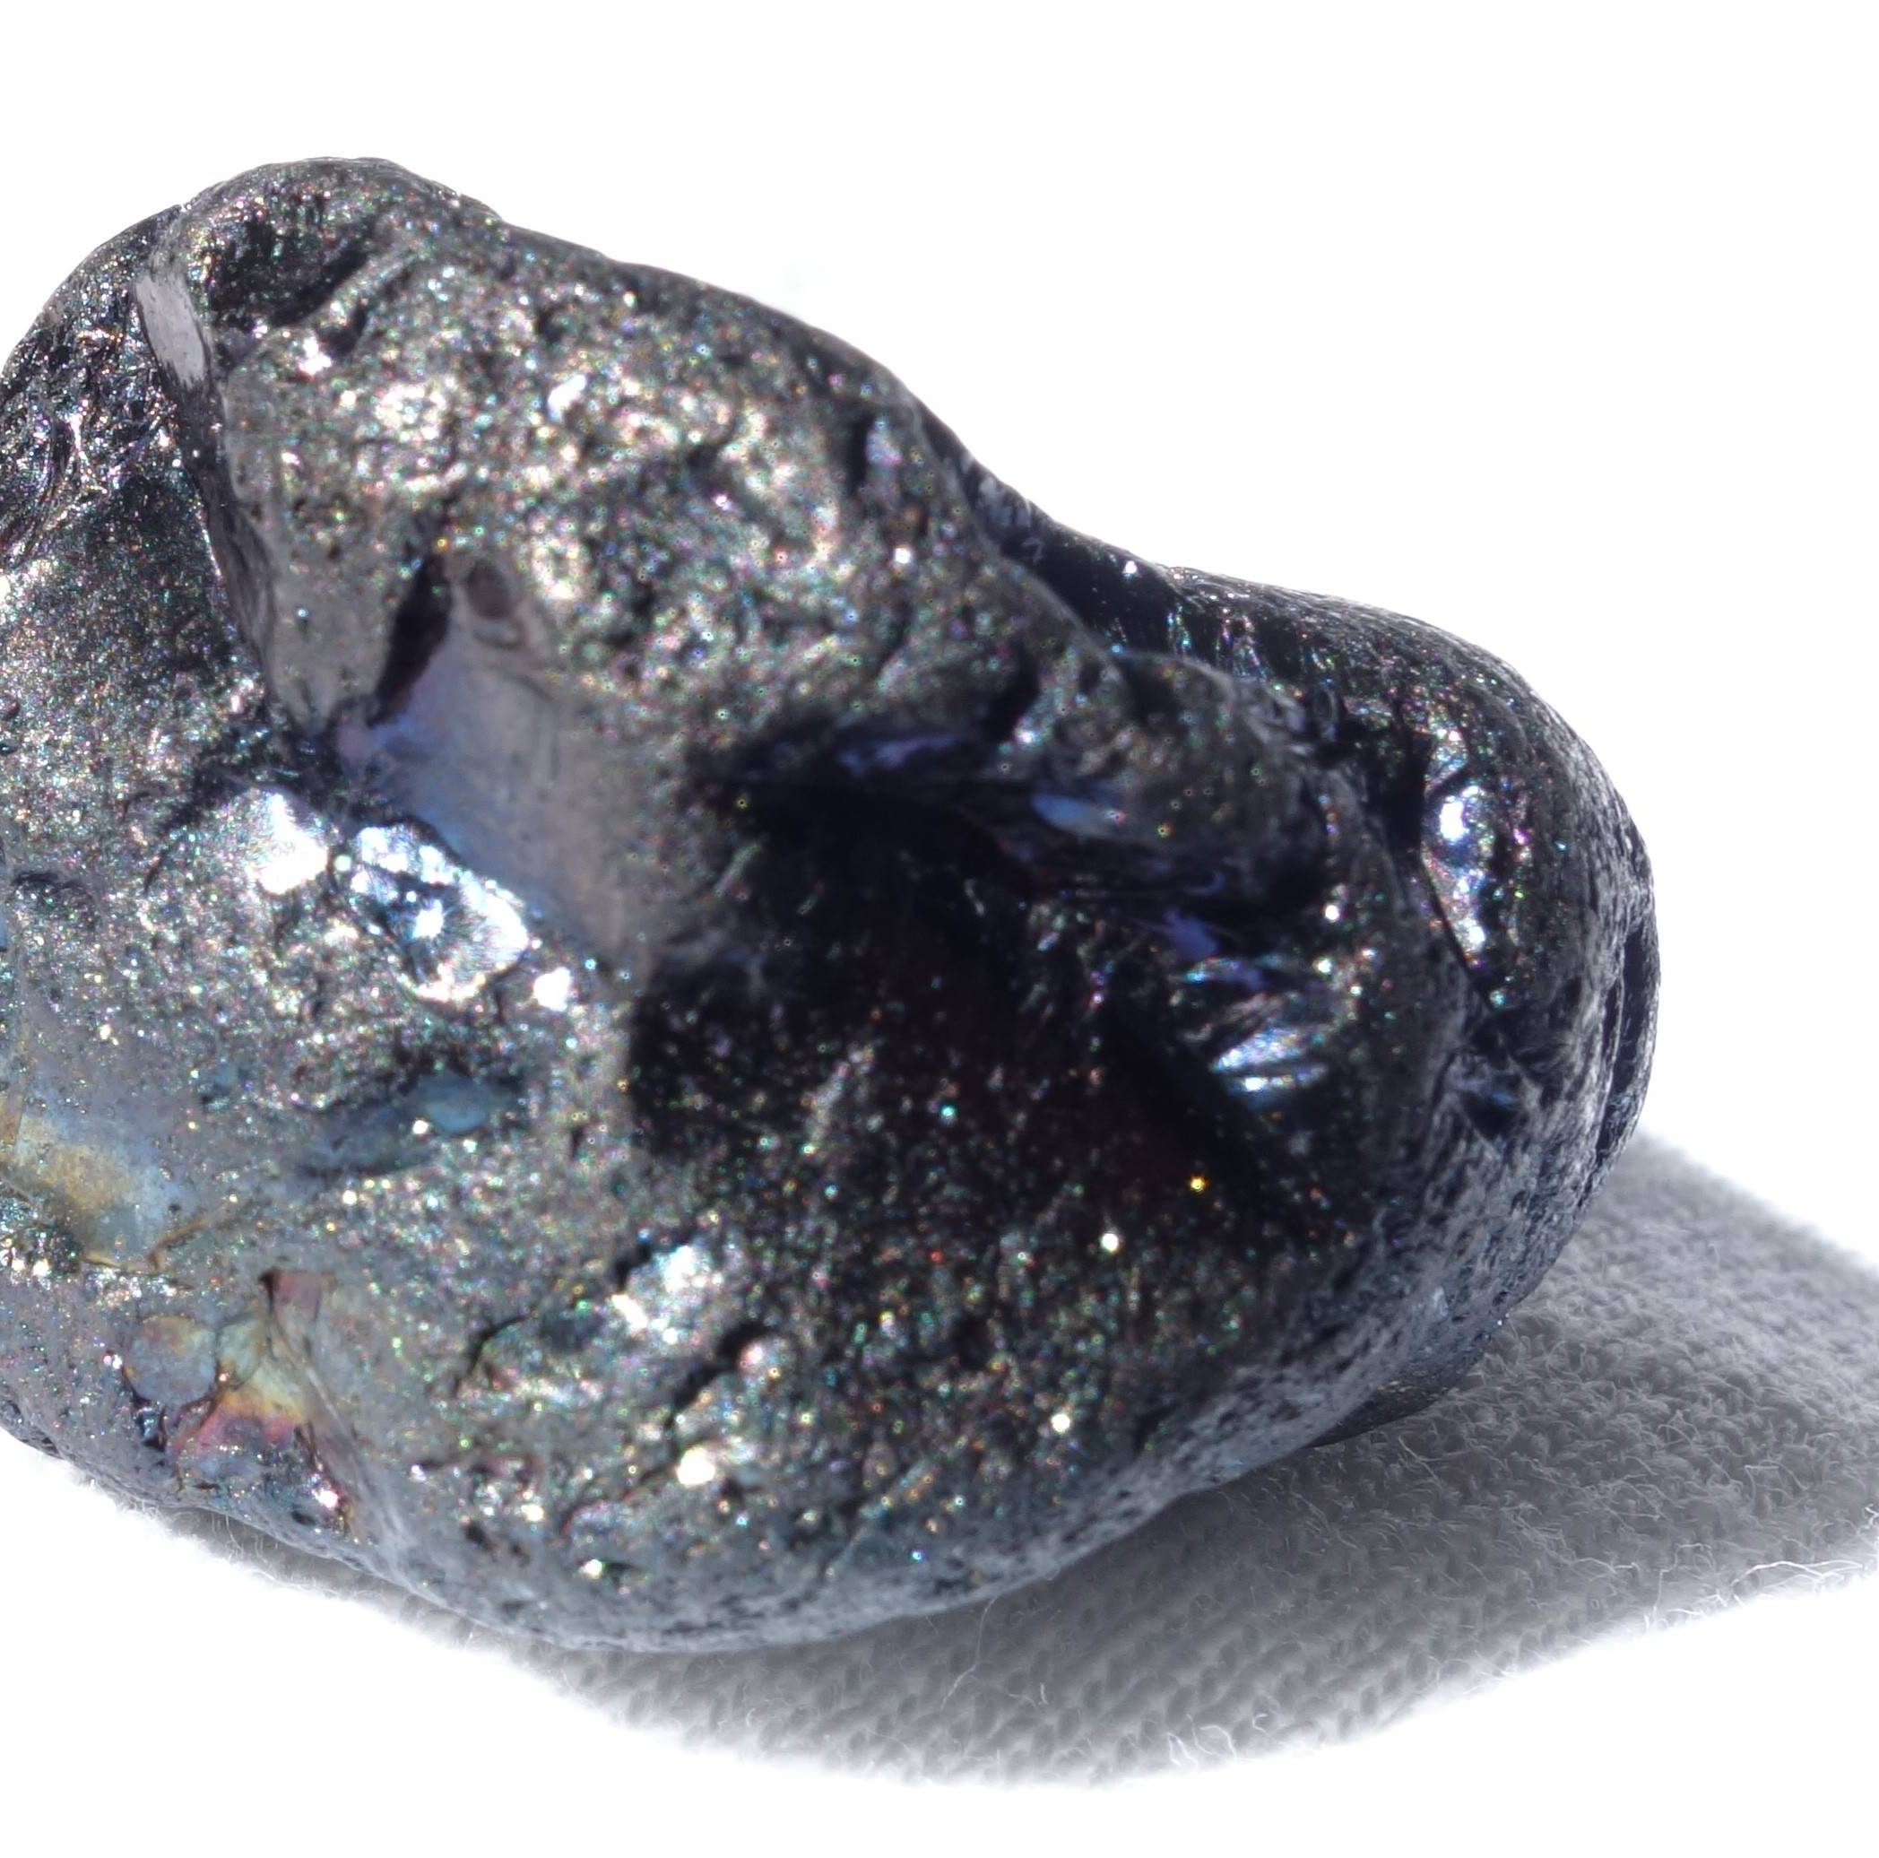
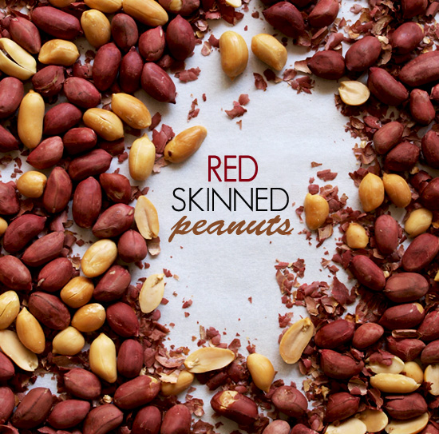
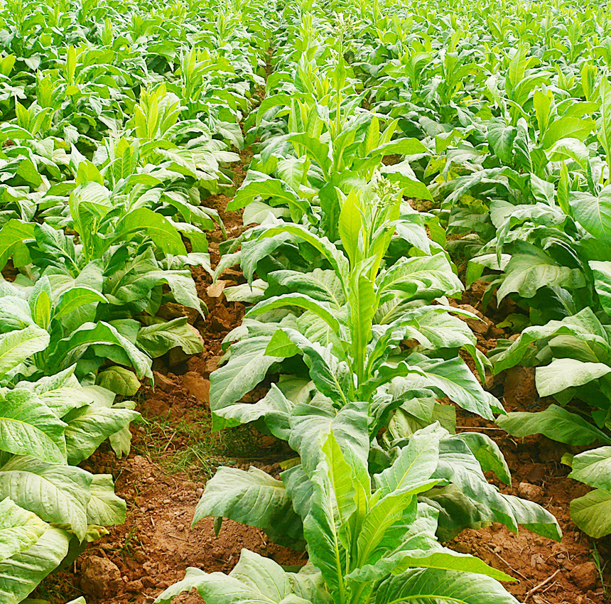
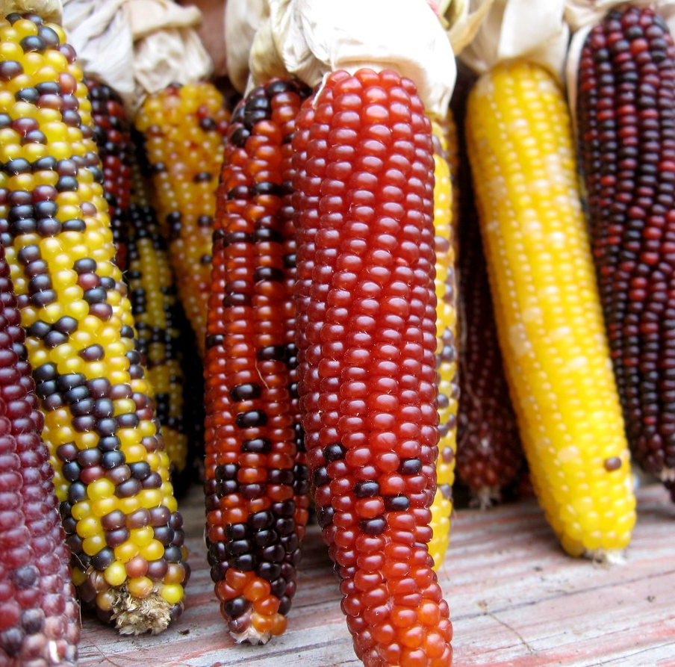
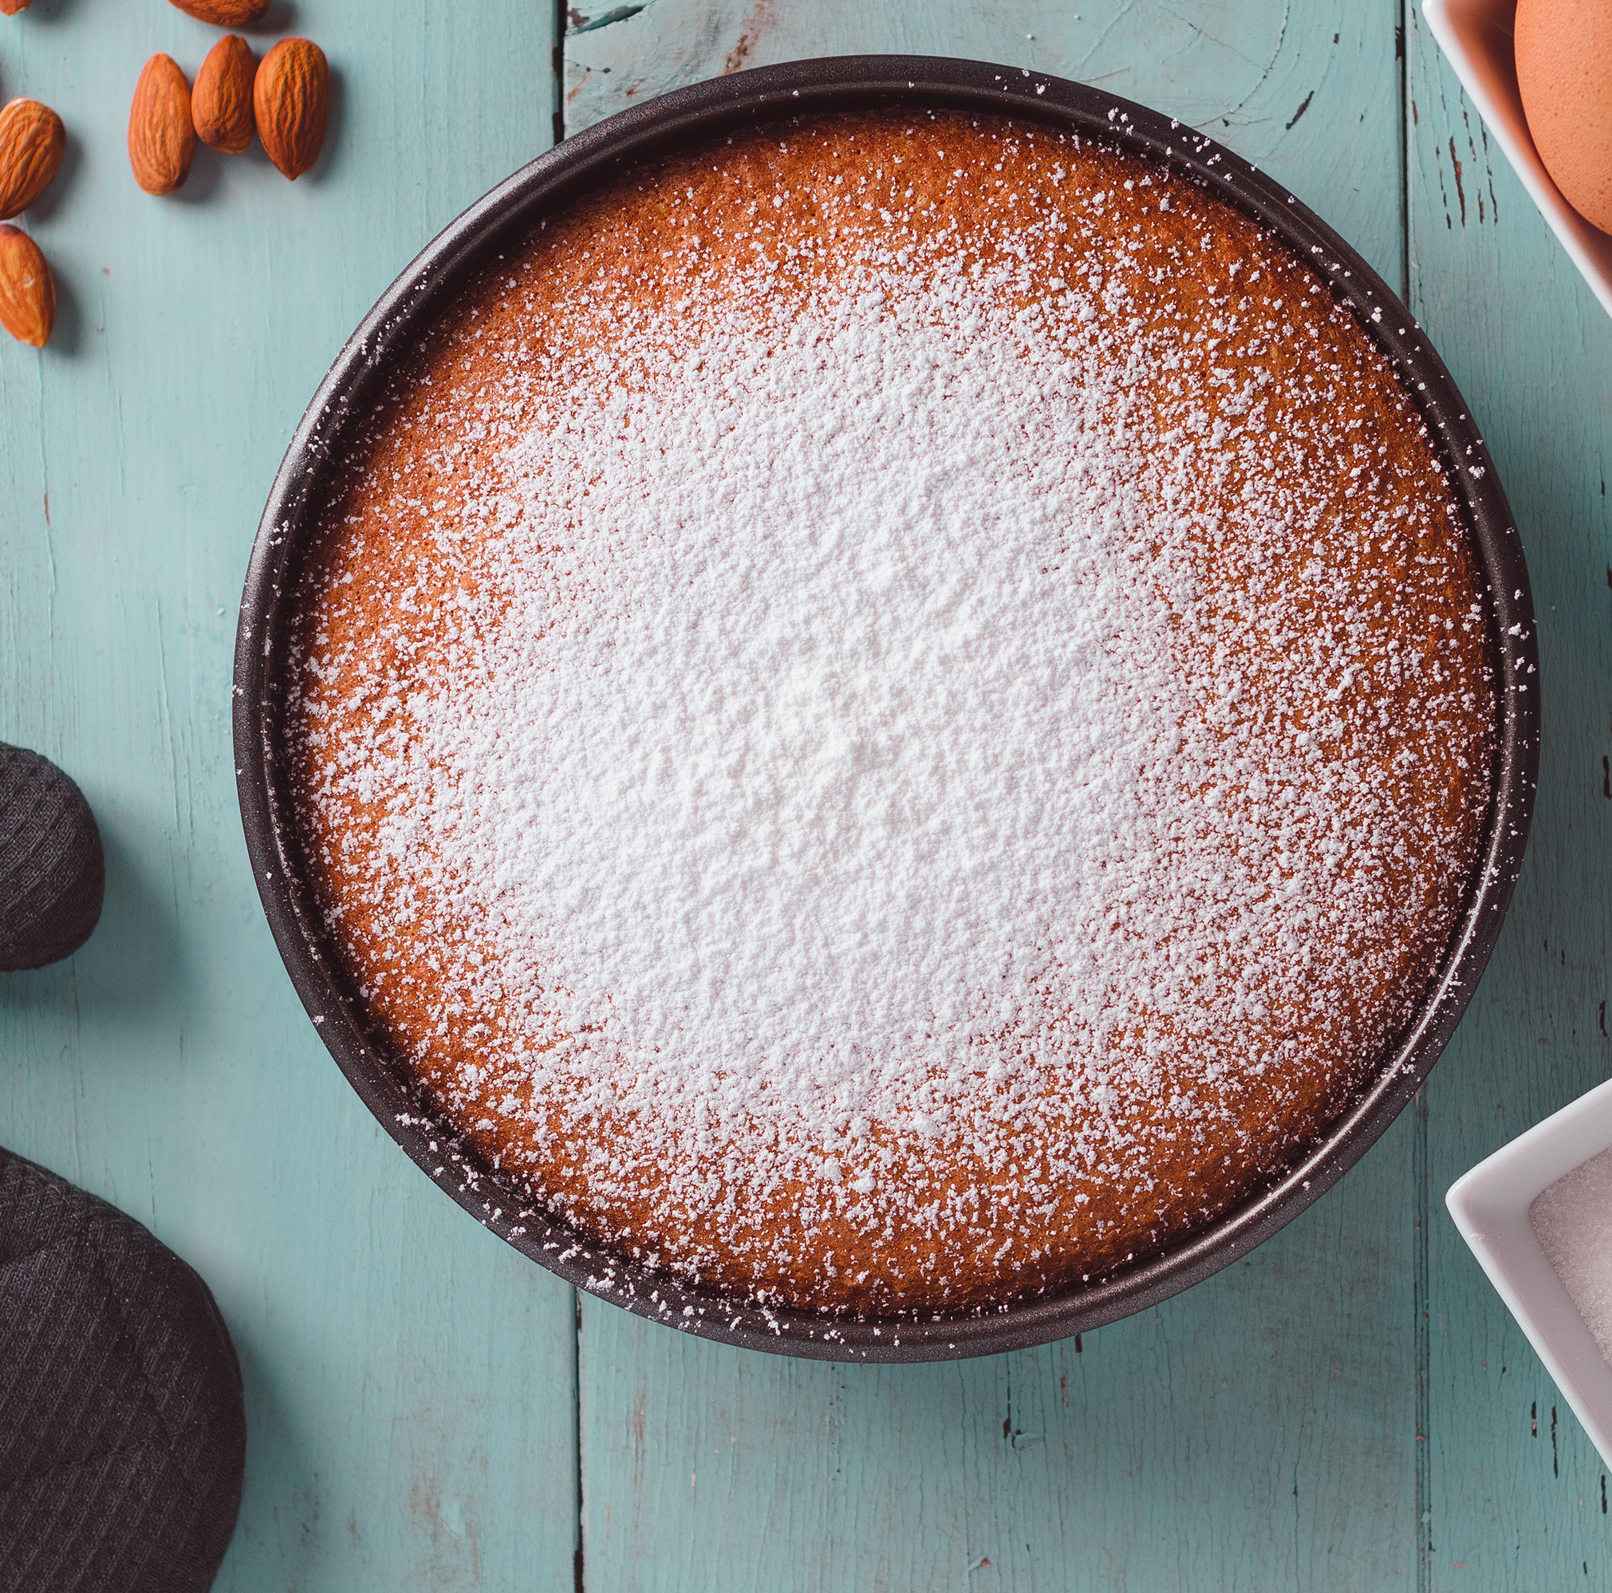
Natural Resources of the Southeast Region
ORENGES &CITUS FRUITE
COTTON PLANT
Oil
coal
Daiond
peanuts
tobacco
corn
sugar

Slide 12
The end

