Slide 1
My Trip to the Southeast

Slide 2
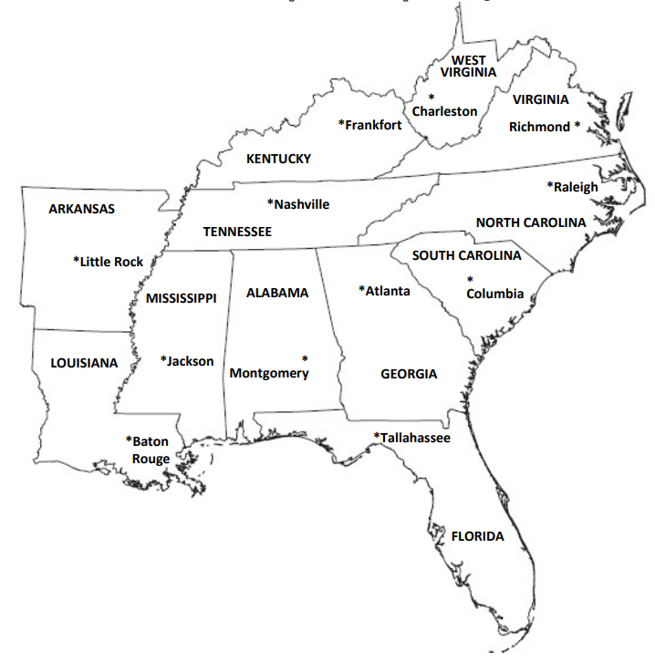
This is a map of the Southeast Region.

Slide 3
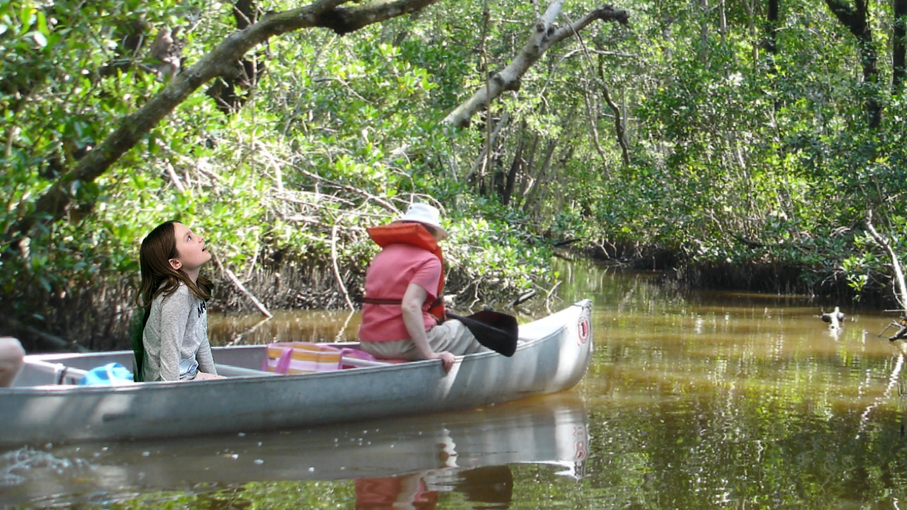
Everglades
Today I went to the Everglades. There are many amazing animals in the Everglades such as alligators, key deer, and bottlenose dolphins too! I even saw some of them on my boat ride through the swamp. The Everglades National Park is a place in the Everglades visited by hundreds of tourists every day.
But not everything in the Everglades is happy and fine. The Everglades is being invaded by the Burmese pythons! I am glad that I didn’t run into any today. On the news this morning, I saw an alligator fighting a python. Yikes!

Slide 4
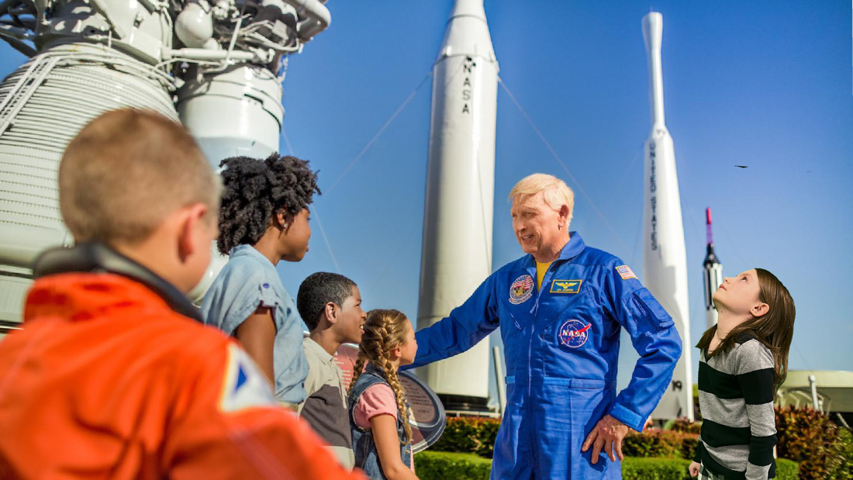
Kennedy Space Center
Today I am at the Kennedy Space Center. On my tour I got to see the famous space shuttle Atlantis and do the space simulations! The tour guide then led me to an actual space shuttle launch. The ground rumbled so much during the launch that I fell off my feet. One of my most favorite things that I did was, at lunch, getting the chance to ask a REAL astronaut questions about what it was like being an astronaut. After the tour was over, I looked around and found an exhibit of actual moon rocks that astronauts had brought back from the moon.

Slide 5
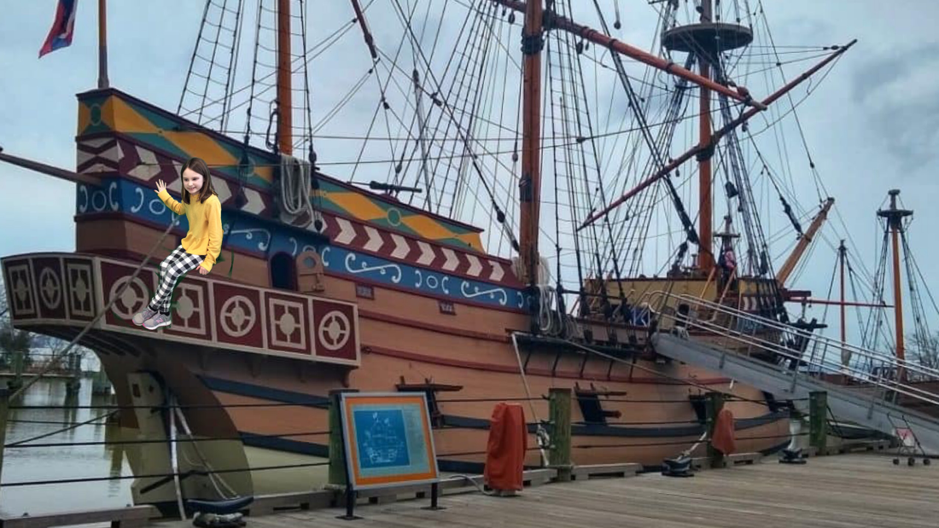
Jamestown, Virginia
Today I visited Jamestown. Jamestown is the home to the very first English settlement. The English colonists faced many hardships once they were settled. Drought, starvation, and diseases were all things that the colonists faced. Mosquitoes that carried Malaria were also in the area. This was a hard time for colonists. But soon, things started to get better. Supply ships came to Jamestown and John Rolfe discovered that tobacco could grow in swampy areas. England got so much more gold, just like they wanted. I learned so many things on the boat tour.

Slide 6
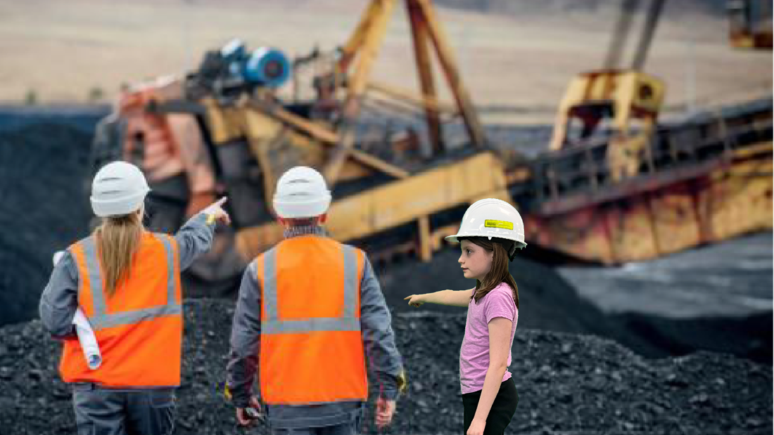
Coal mines in Appalachia
Today I am at a coal mine in Appalachia listening to the music, bluegrass. Coal is a mineral that is very important to the southeast. Almost all of the coal in the United States comes from the underground and strip mines that are in Appalachia. Appalachia sits right in the middle of Tennessee, Georgia, and Alabama. Coal is often used to make electicity for homes and businesses around the United States. You were probably wondering all this time what a strip mine is. A stip mine is a place where minerals are scraped from the ground. I had a fun time learning about coal mines. See you at the next stop.

Slide 7
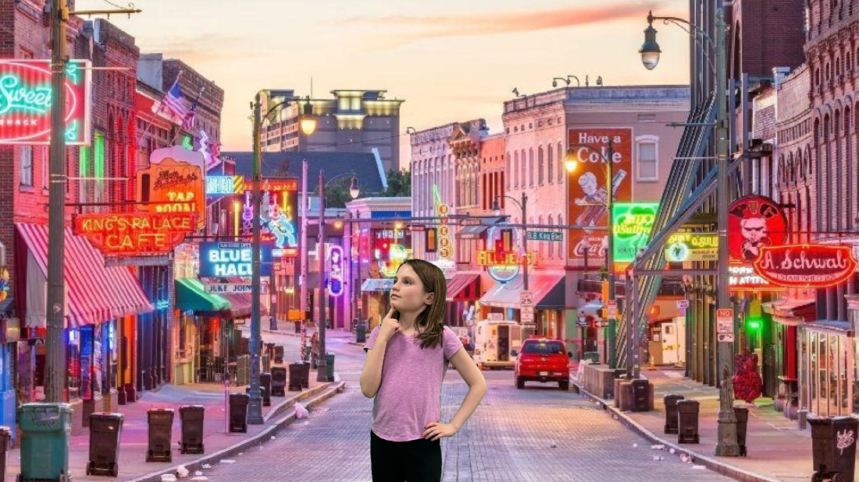
Memphis, Tennessee
I made a short stop in Memphis, Tennessee, where a street trombone player told me the history of Memphis, Tennessee. This place is known as the birthplace of the “blues”. The blues were created by slaves as a way to express their sorrows. In 1912, W.C. Handy, an African American songwriter in Memphis, wrote the first popular blues song, which he called “Memphis Blues”. Today the blues can be heard throughout Memphis! After lunch, I went on a tour down the Mississippi River. See you at the next stop!

Slide 8
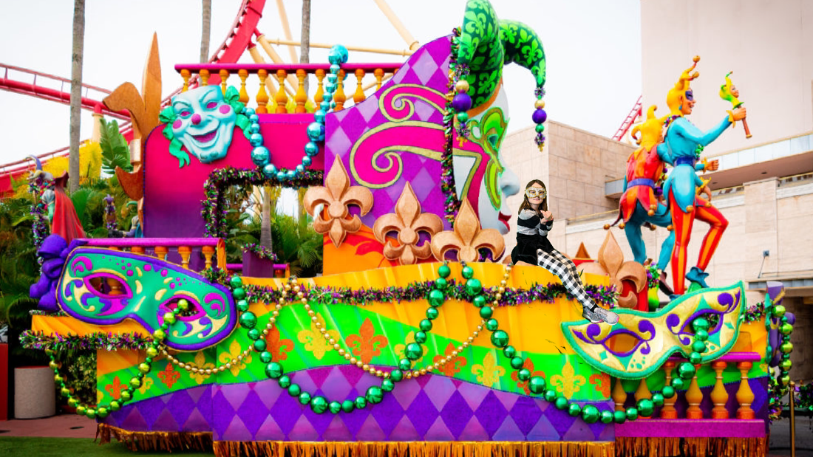
The French Quarter in New Orleans, Louisiana
Today’s stop was a jazzy one, and I think you can guess why. That’s right. New Orleans. Home to the birthplace of jazz. Also, home to the most famous African American jazz musician of all time. Louis Armstrong. And what a lucky time to arrive. In the preparation of Mardi Gras! I visited all the preparation sites and got my first ever glance of a real king cake! (They even let me taste test it. Mmmmmmm). I saw the Mardi Gras floats behind the scenes while they were painting them. Then I got my dress made for the Mardi Gras celebration. Happy Mardi Gras! By for now!

Slide 9
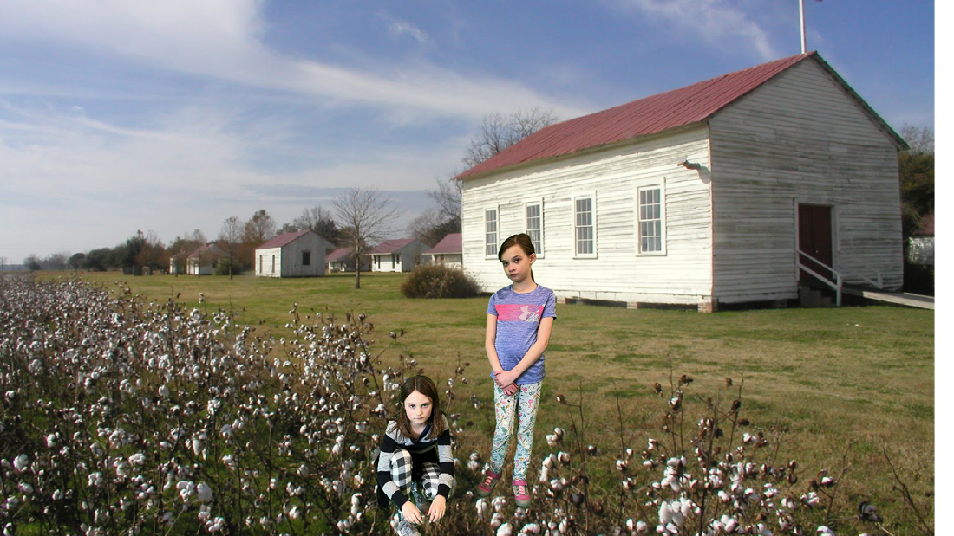
A Cotton Plantation in Natchez, Mississippi
Today I made a sad visit to a cotton plantation in Natchez, Mississippi. This place was where, back then, black slaves worked for rich white people. The white people got to live in huge mansions, while the black slaves lived in tiny wood houses. White people got their money from all the cotton they prudused, but it was actually the slaves that picked the cotton. It was really sad what had happened to these poor slaves. I am glad that slavery was vanqueshed from the U.S. in the Civil War. See you as the next happyer stop!

Slide 10
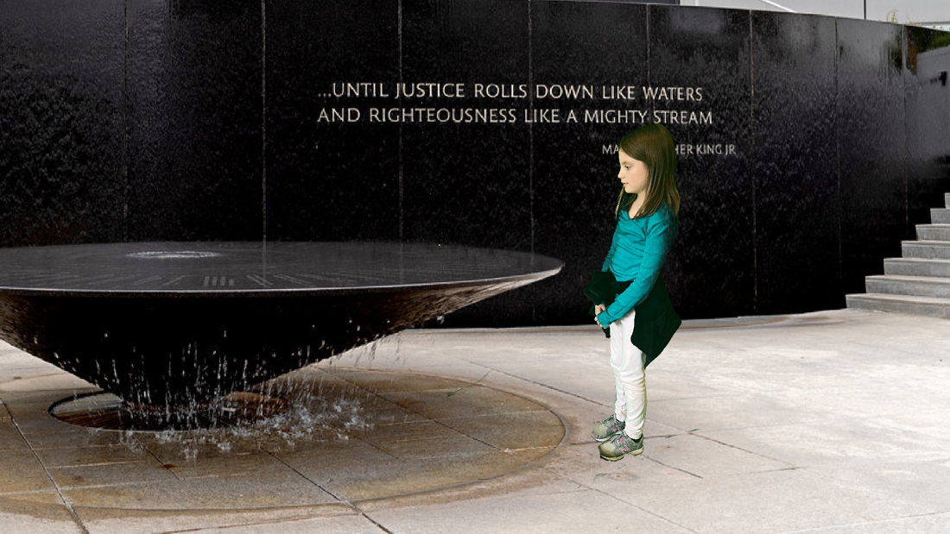
Birthplace of the Civil Rights Movment, Montgomery, Alabama
Today I made an important stop to the birthplace of the Civil Rights Movment, Montgomery, Alabama. Back then (the 1950’s), during segragation, African Americans were treated unfairly. They were unhappy with the unfair laws on the buses that made them have to sit at the back of the bus. Two imporntant black Civil Rights leaders, Martin Luther King Jr. and Rosa Paks helped protest about unfair laws on buses and lead a bus boycott across Montgomery, Alabama. This led to the Civil War. After the Civil War Montgomery put up a Civil Rights memorial where 40 names of important Americans were engraved in the stone.

Slide 11
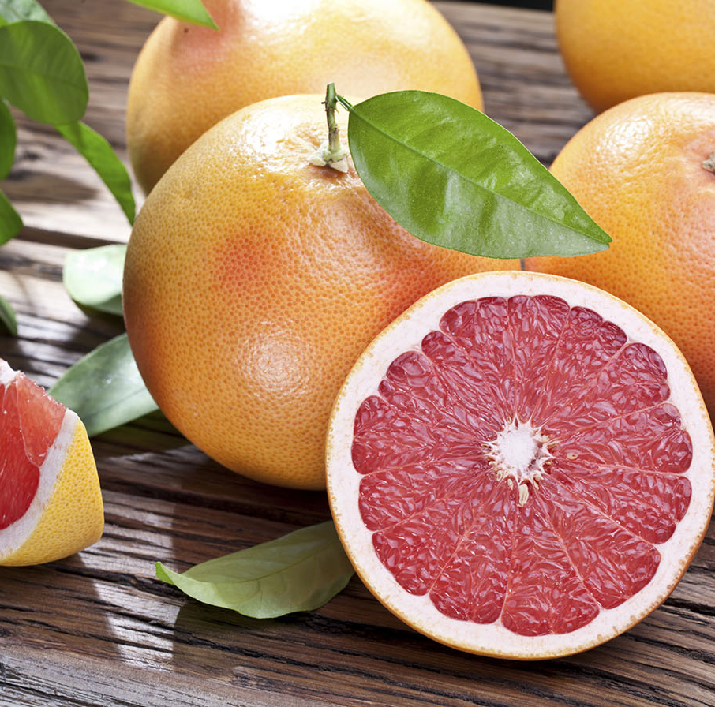
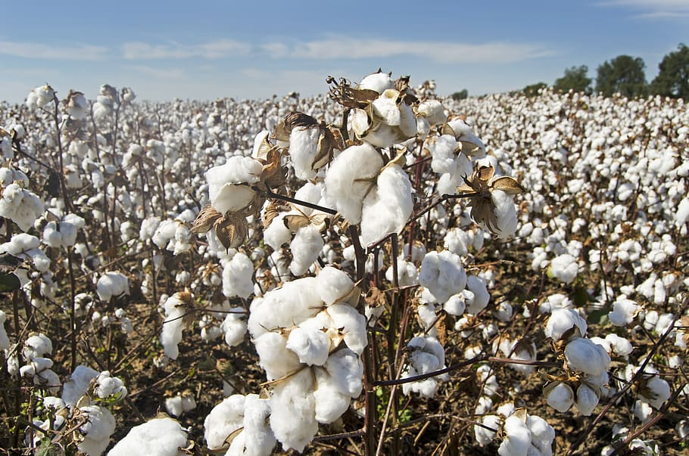
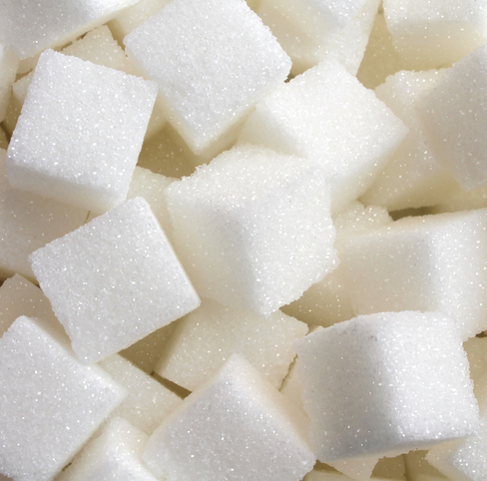
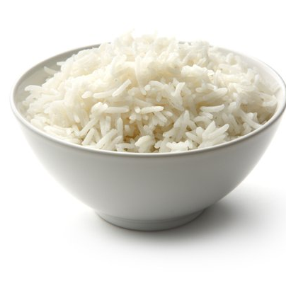
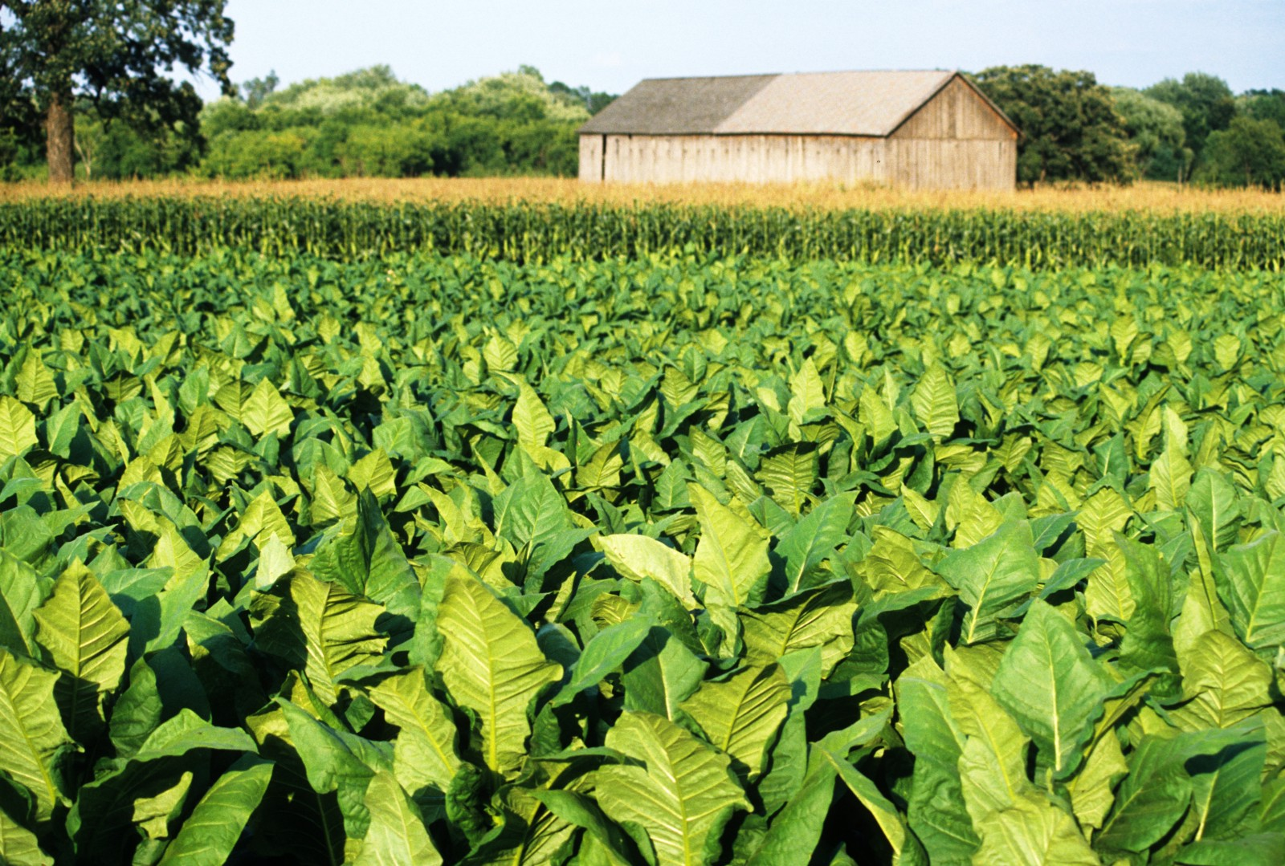
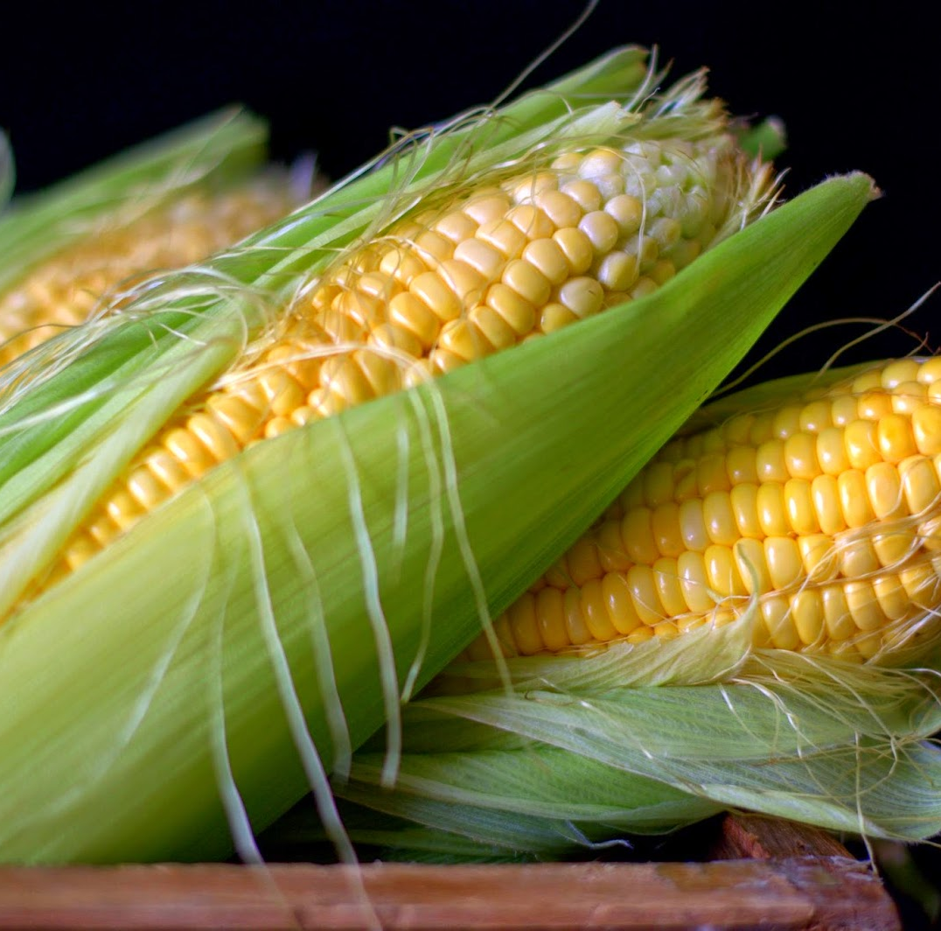
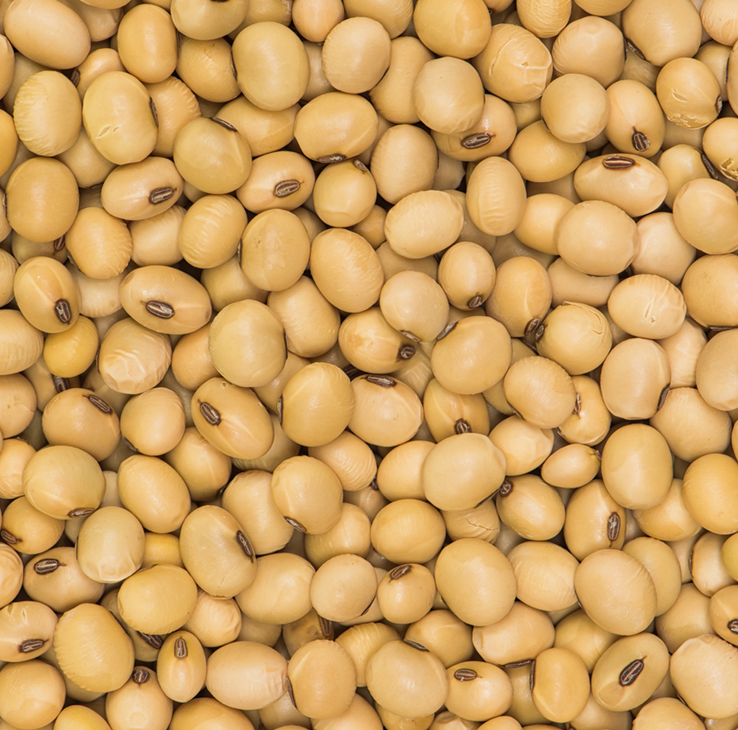
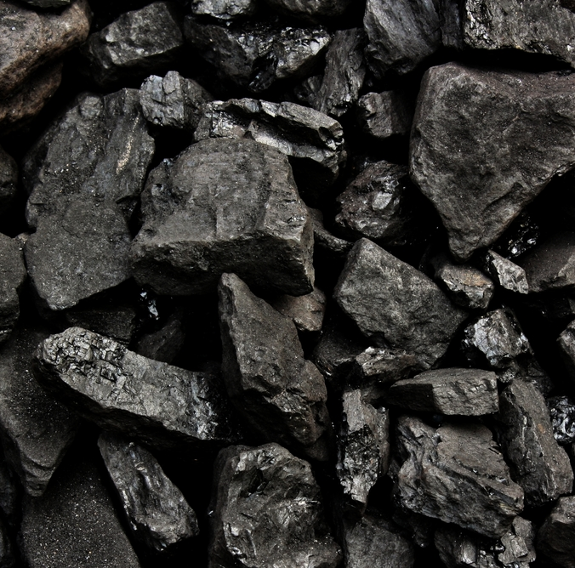
Natural Resources of the Southeast Region
Oranges and citrus fruit
Cotten
Sugar
Rice
Tobacco plant
Corn
Soy beans
Coal
This Photo by Unknown Author is licensed under CC BY

Slide 12
Epilogue
I had an amazing time in the Southeast, and enjoyed every moment of it. I hope you get to visit the Southeast too and have as much fun as I did!
As a thank you, I will give you a summery of the places I visited. First up, the Everglades. We learned that endangered animals live in the Everglades and that it is nicknamed “the sea of grass” because it is covered in swampy, grass covered land. The next place we visited was the Kennedy Space Center. There, we got to visit the astronauts that actually flew to outer space and ask them questions! Not long afterwards, we visited Jamestown, Virginia, and learned about English colonists traveling to Jamestown. Then we visited a coal mine in Appalachia, were we learned how important coal is to the Southeast. We also visited Memphis, Tennessee and New Orleans, which are the party places. Last but not least, we visited a cotton plantation in Natchez, Mississippi and Montgomery, Alabama which are places of segregation and African American slaves, sad places. Well, I hope you liked our visit to the Southeast. Bye!

Slide 13

Ella C. Wallent
Warning! This book is a journal entry book from hundreds of years ago. Please be very careful turning the pages of this book. Nothing is more important than an educational book about the Southeast. In this book you will read many entries about places in the Southeast. You will also discover the importance of each stop. Natural resources are found in the book, if you know where to find them. You will learn about the Everglades, the Kennedy Space Center, Jamestown Virginia, and so much more! To open this book, repeat this spell:
Alaca, Alaco, we will learn so much to go,
Alaca, Alaco, it will be so fun you know,
Traveling to mysterious places,
To find things that are amazing,
Alaca, Alaco, we will learn so much you know

