Slide 1
My Trip to the Southeast
By Chris J

Slide 2

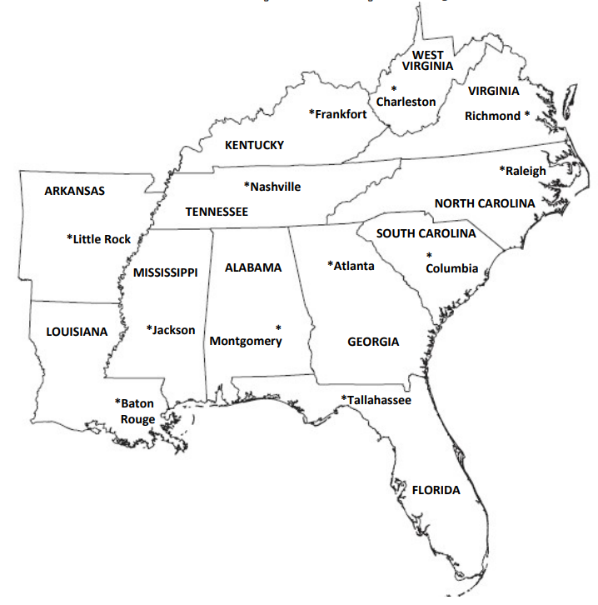
This is a map of the Southeast region

Slide 3

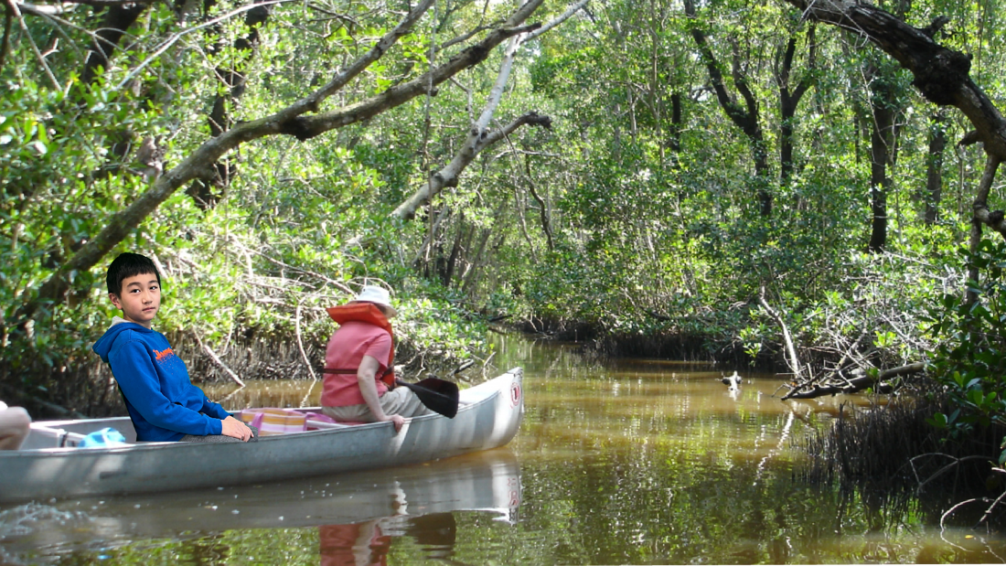
Everglades
Me on a boat tour in one of the Everglade’s rivers
Today I traveled to the Everglades, in southern Florida.
Pretty much everywhere I looked there were swamps and marshes. It’s really hot here and there are alligators' snakes, and birds everywhere!
Did you know there are more than 2000 species of birds living here? I can’t wait to get a picture of the Florida Panther!

Slide 4
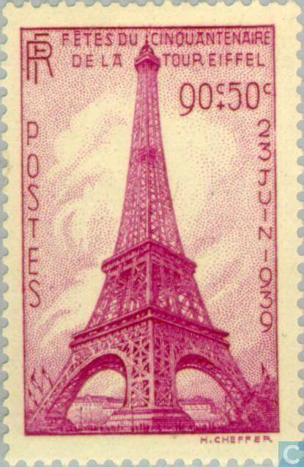
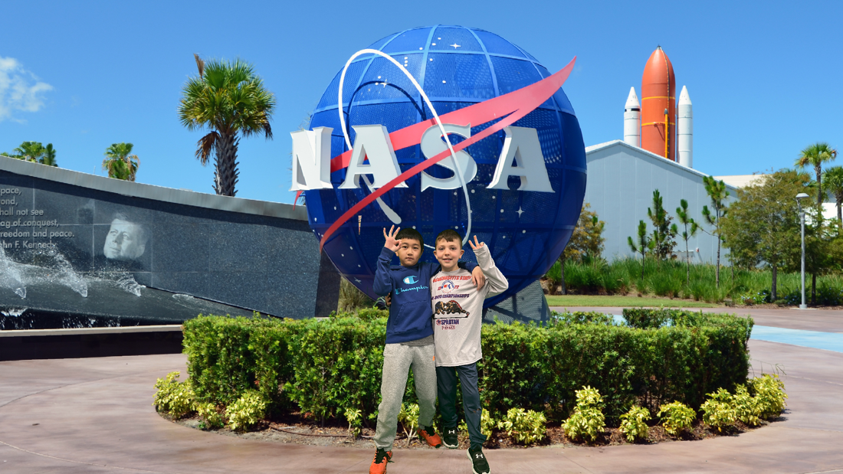
Kennedy Space
Center
Me and my friend Henry at the
Kennedy Space Center
Today I visited the Kennedy Space center at the east coast of Florida. I even brought my friend Henry with me! Together, we saw tons of attractions such as the Atlantis space shuttle, the model of the Hubble space telescope, and the chunk of Moon rock! When we walked under the Apollo spaceship, we felt as puny as ants. It truly is huge! Finally, we went to the rocket ship flight simulator which showed us what flying to space was like. One second, we were just sitting there in our seats. And the next, my skull was being rattled and pounded by the G-force. It was like a VERY fast roller-coaster. We definitely enjoyed this trip.

Slide 5
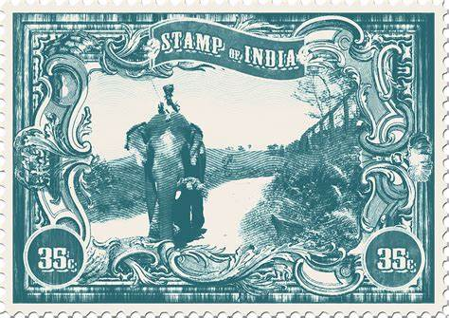
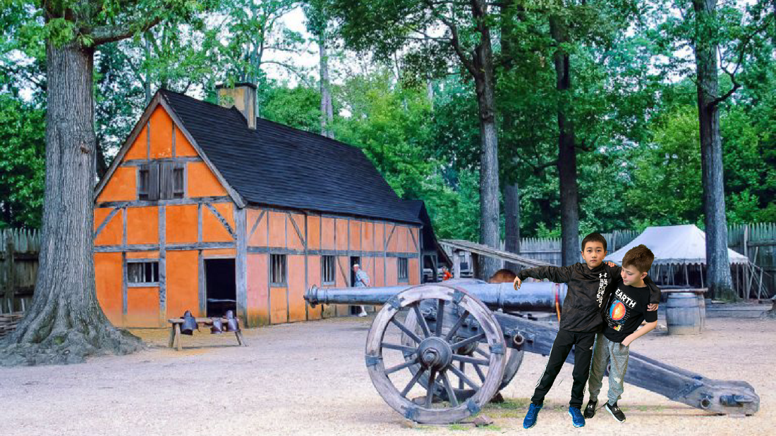
Jamestown
Today, I visited Jamestown in Virginia with Henry. It’s the place that the first English settlers arrived at. The English battled through hardships like mosquitoes and a drought. The English settlers arrived in 1607 and only a couple of years later, began to thrive. My favorite part of this trip was when I got to take a photo next to a cannon in the village. All in all, this place helps you go back in time, and understand how the place used to look, smell, and sound like. I highly recommend that you visit this place sometime soon, it is truly an unforgettable location.

Slide 6
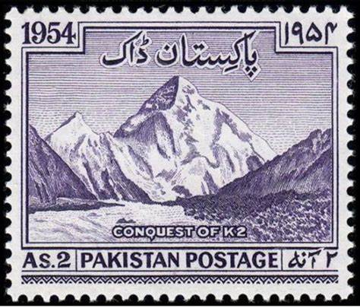
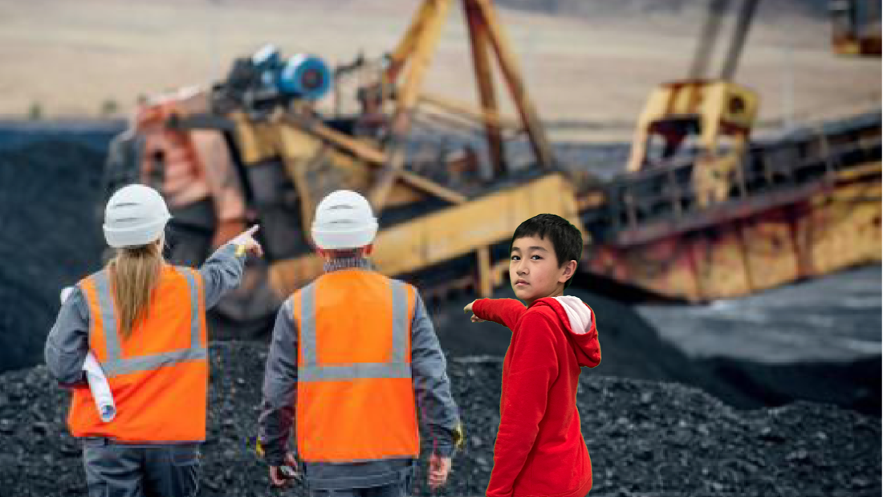
Coal mine in Appalachia
Today, I visited a coal mine in Appalachia. I was able to see how workers used their machines to extract the coal from the mine. Even though I wasn’t able to go inside, the experience was still quite exhilarating. When I looked down the mine tunnel, all I saw was an endless abyss of darkness. Now I don’t want to go down there anymore.

Slide 7
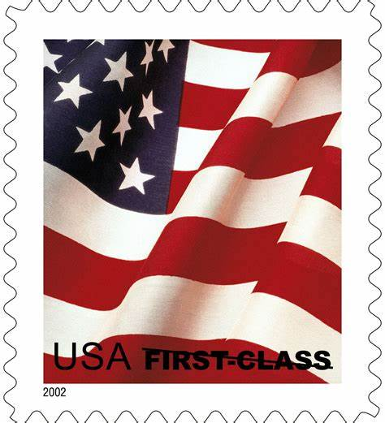
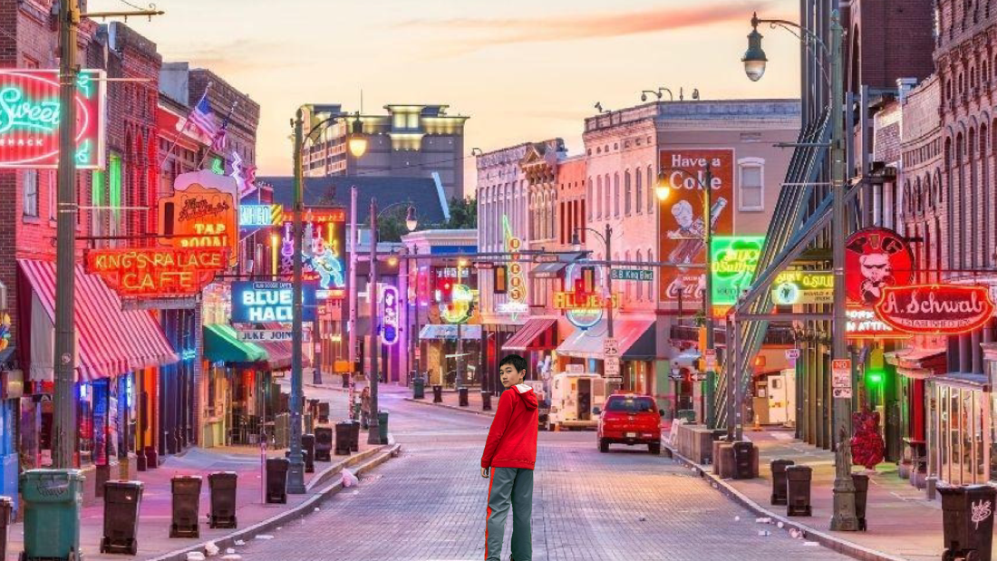
Memphis, Tennessee
Today, I made a short stop in Memphis, Tennessee. This place is known as the birthplace of the “blues.” A popular style of music in Memphis. The blues were created by slaves as a way to express their sorrows through music. Today, the blues can be heard throughout Memphis.

Slide 8
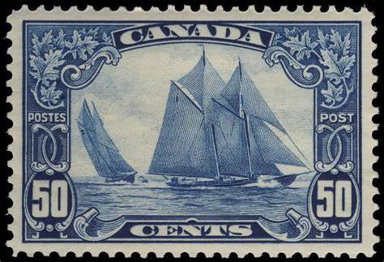
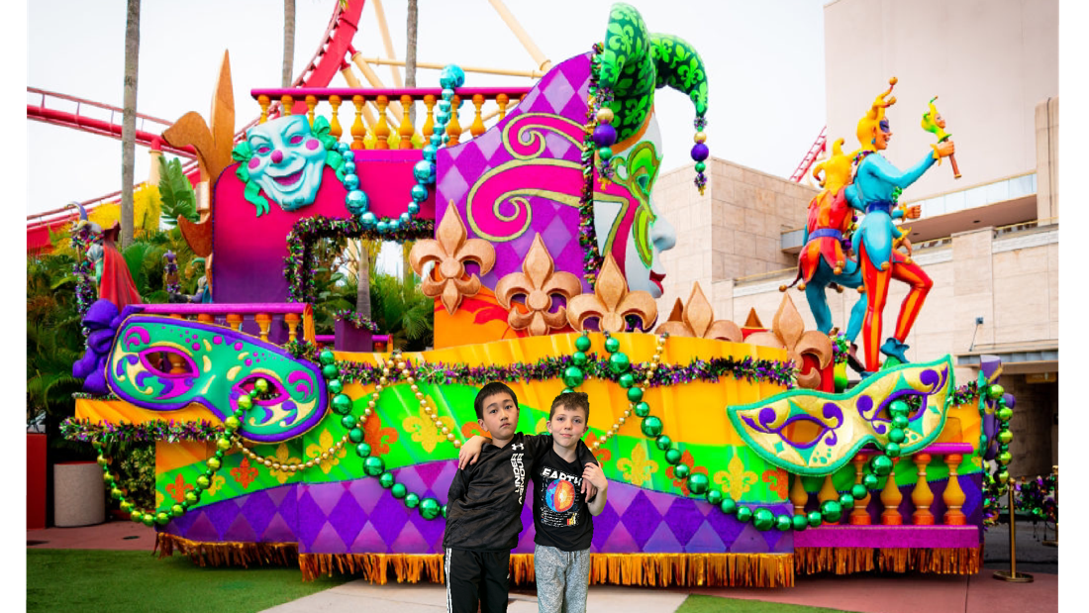
French Quarter
Today I visited the French Quarter in New Orleans with Henry. Everywhere I looked, there were musicians on the streets playing jazz. I also tried spicy Cajun food. It is delicious! Did you know, Cajun food was named after the Cajun way of lifestyle? This was probably my favorite stop for this entire trip, I want to visit again!

Slide 9
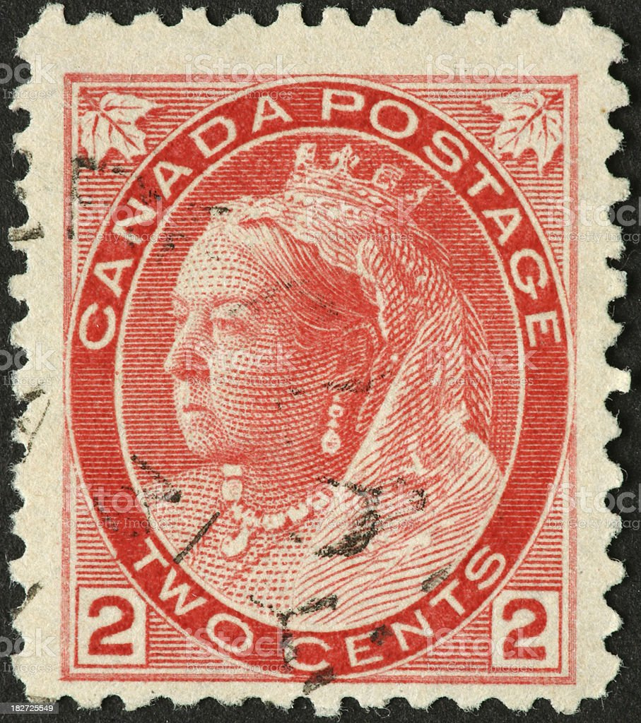
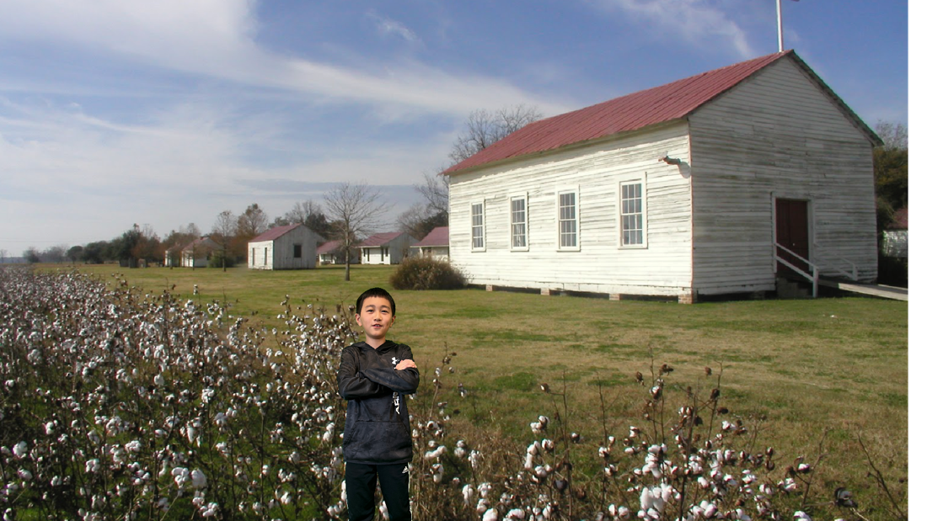
A cotton plantation in Natchez Mississippi
Today I visited a cotton plantation in Natchez Mississippi. In the 1800’s white owners lived in Mansions and relaxed, while their slaves had to work hard. It was really sad that there used to be slavery in the south. I’m glad that slavery has been abolished!

Slide 10
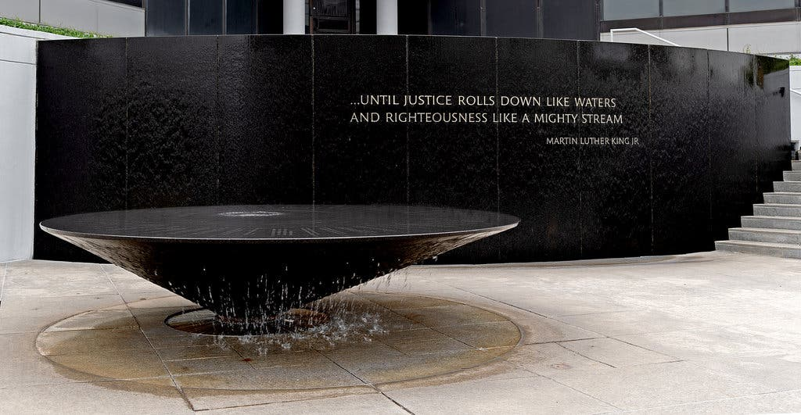
Montgomery Alabama
Today I visited the Civil Rights Memorial in Montgomery Alabama.
Leaders like Dr. Martin Luther King Jr made great efforts to end segregation. After Rosa Parks was arrested, black people had a bus boycott. It is very sad how white people used to treat black people in the 1950’s.

Slide 11
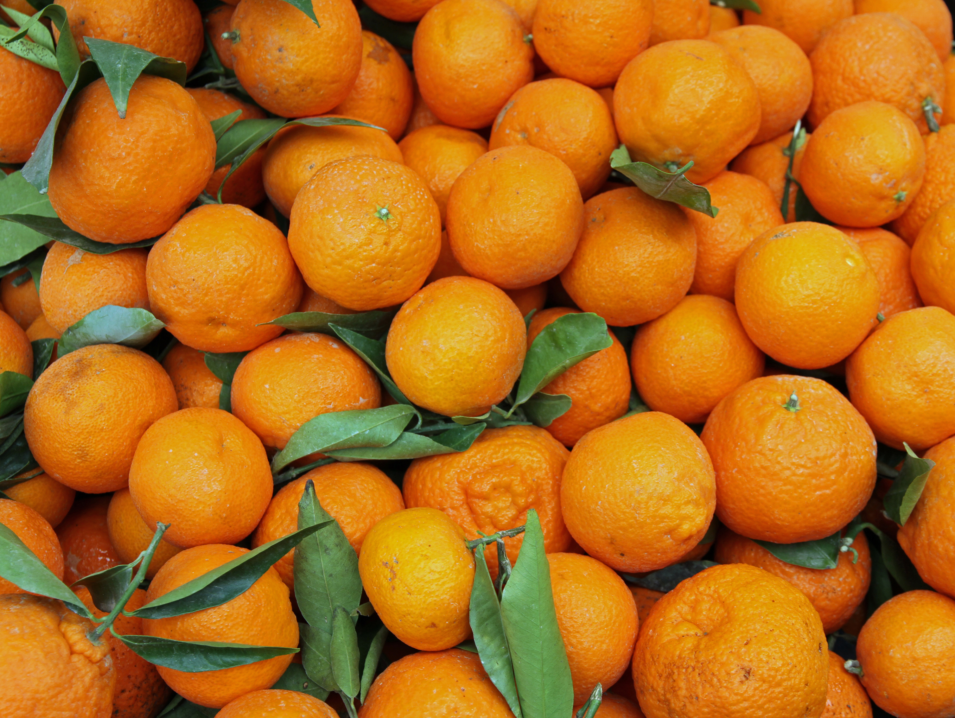
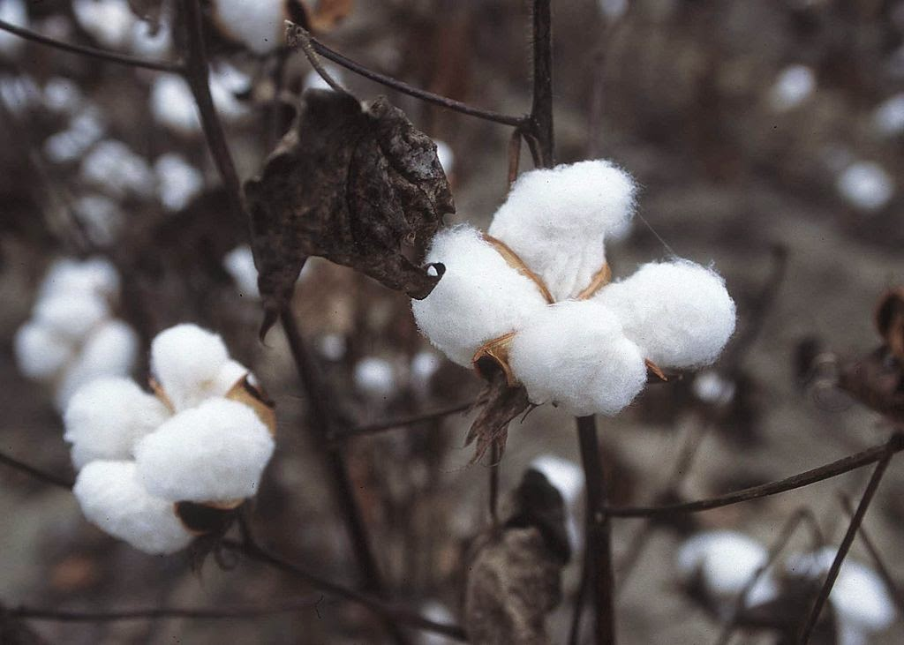
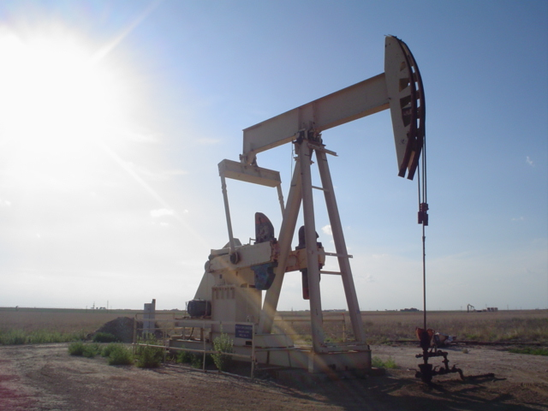
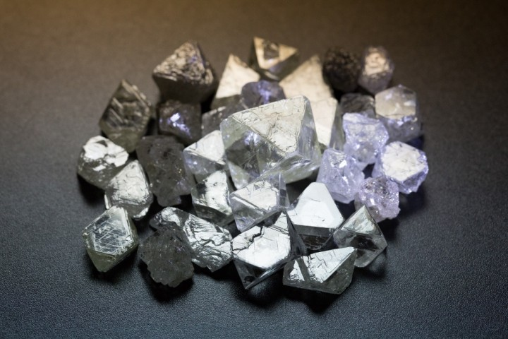
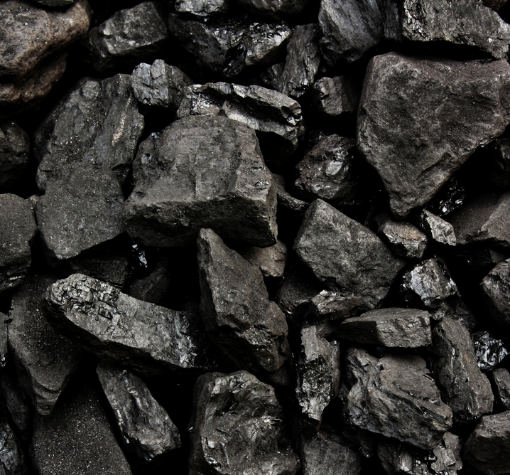
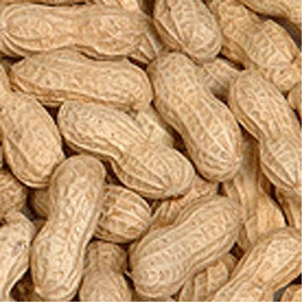
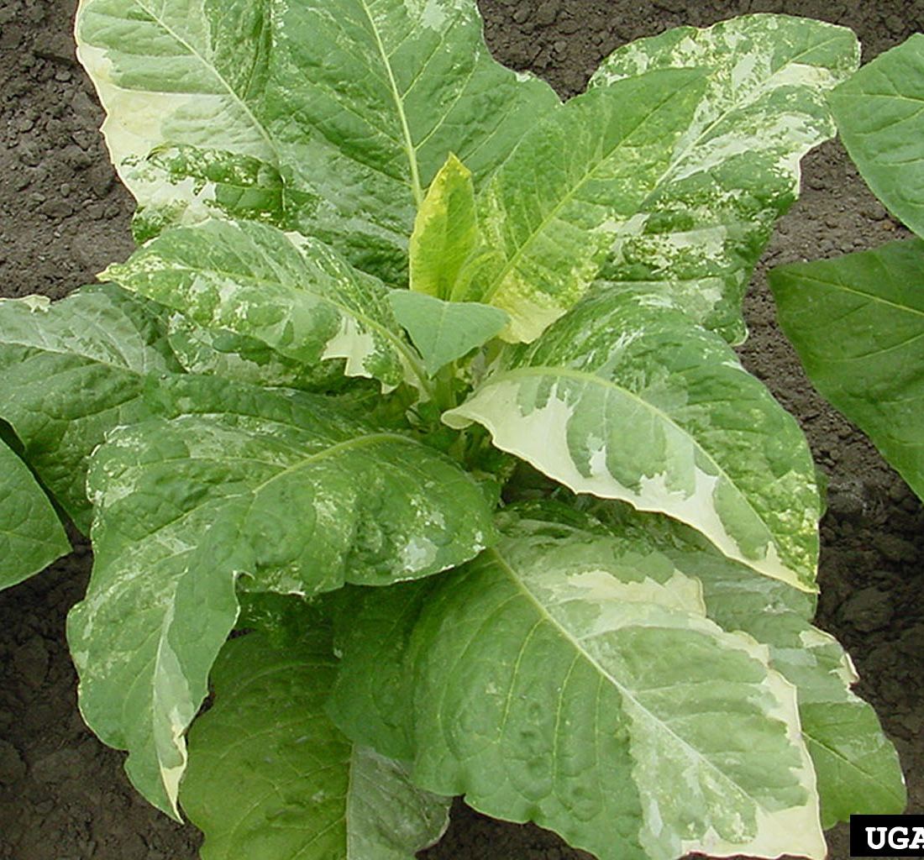
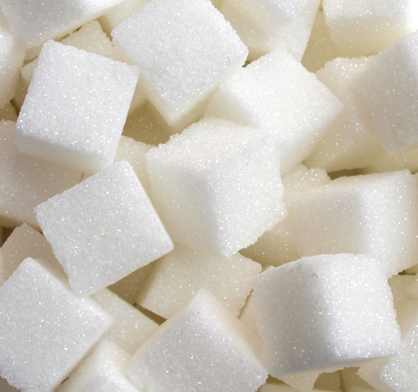
Natural Resources of the Southeast Region
Oranges & citrus fruits
Cotton plants
Oil
Diamonds
Coal
peanuts
Tobacco
Sugar

Slide 12
Template created by SlidesMania

